Slide 1

Interfacing UART with
ARM7 LPC2148
DAY 13
EMBEDDED SYSTEM DESIGN & IoT-Master Class

Slide 2
What You will learn Today?
What is UART
How it works
UART Registers in LPC2148
Functions for UART Transmit and Receive
Code

Slide 3
Mindset Lesson for the Day
Don’t do the Same thing and expect different result.

Slide 4
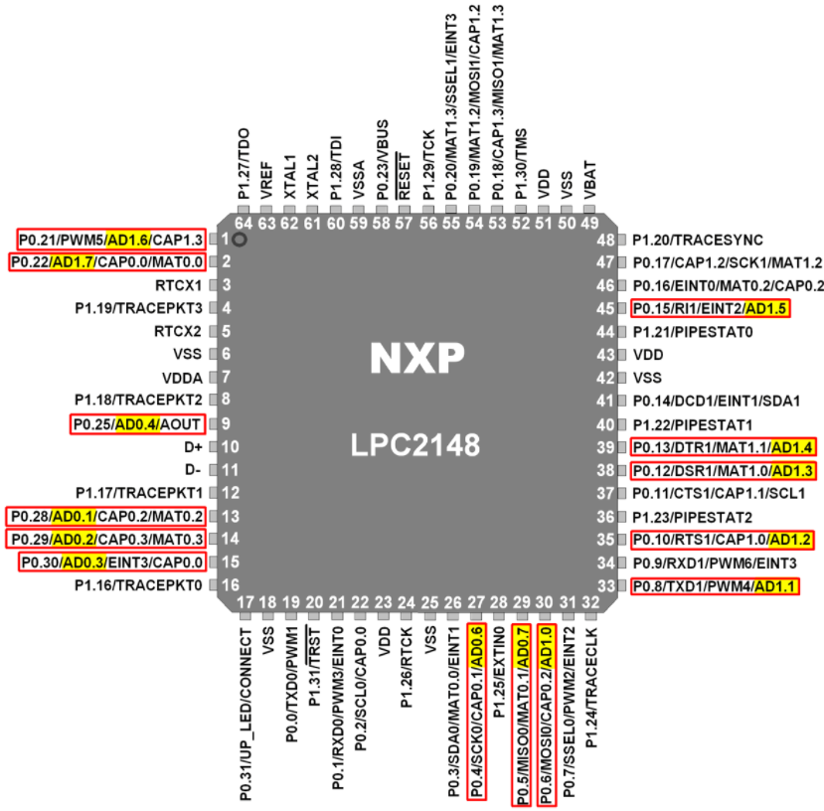
UART PIN DETAILS

Slide 5
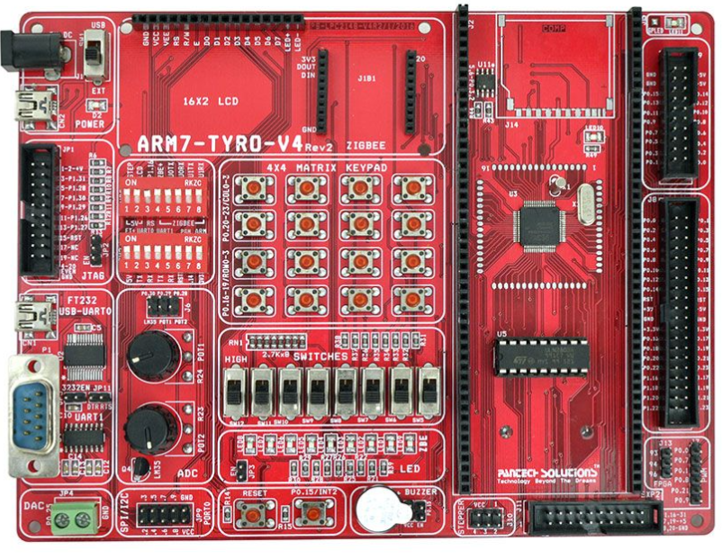
ARM7 Development Board

Slide 6
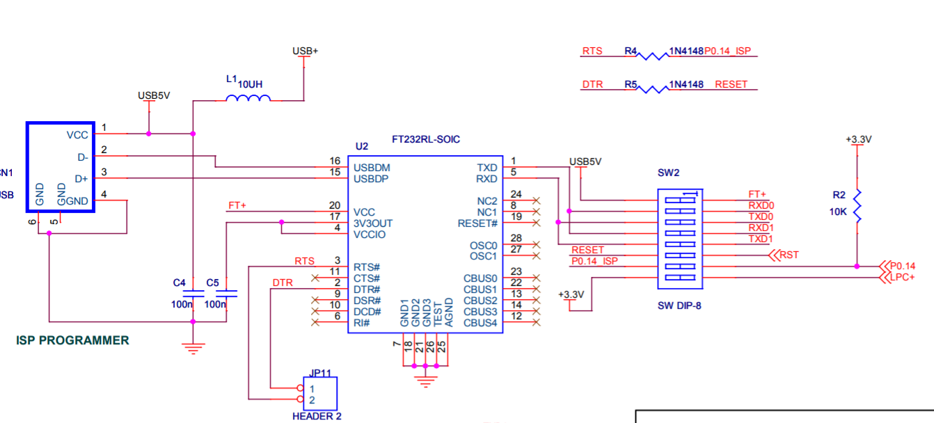
FT232

Slide 7
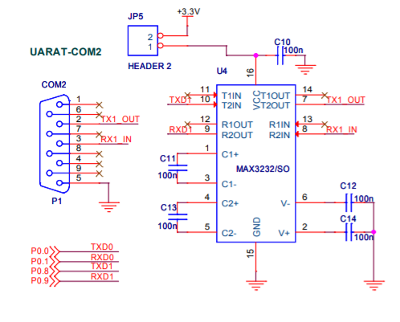
UART

Slide 8
WHAT IS UART
Universal asynchronous receiver and Transmitter
Serial port, COM port, RS232, RS485
VERY COMMON AND SIMPLE
Useful for communication to
  Microcontroller
  Computer
  Other FPGA

Slide 9
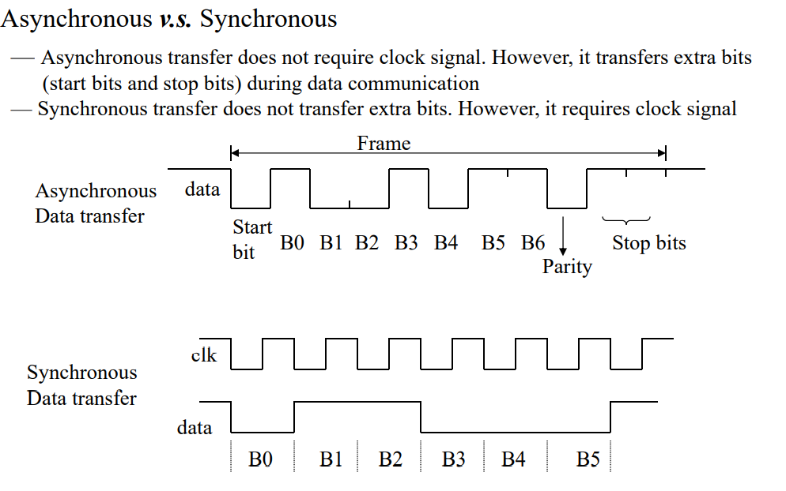
Asynchronous Vs Synchronous
Two methods of serial communication are
Synchronous Communication: Transfer of bulk data in the framed structure at a time
Asynchronous Communication: Transfer of a byte data in the framed structure at a time

Slide 10
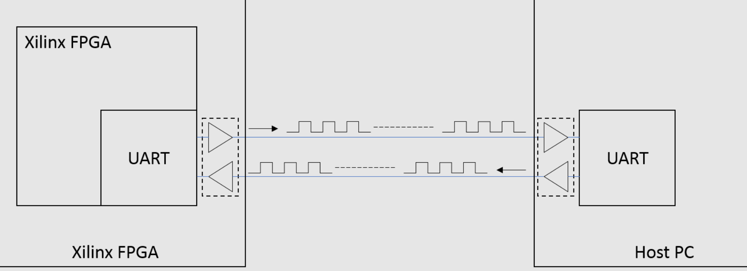
UART

Slide 11
UART PARAMETERS
Baud Rate (9600, 19200, 115200, others)
Number of Data Bits (7, 8)
Parity Bit (On, Off)
Stop Bits (0, 1, 2)
Flow Control (None, On, Hardware)

Slide 12
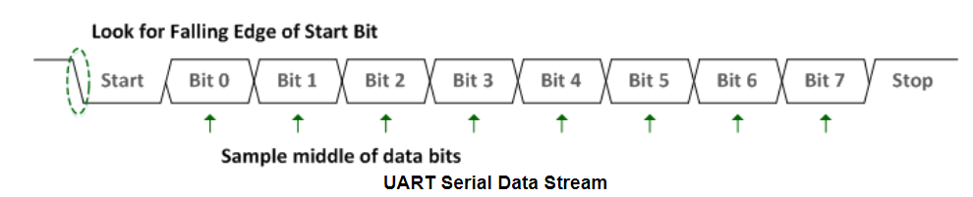
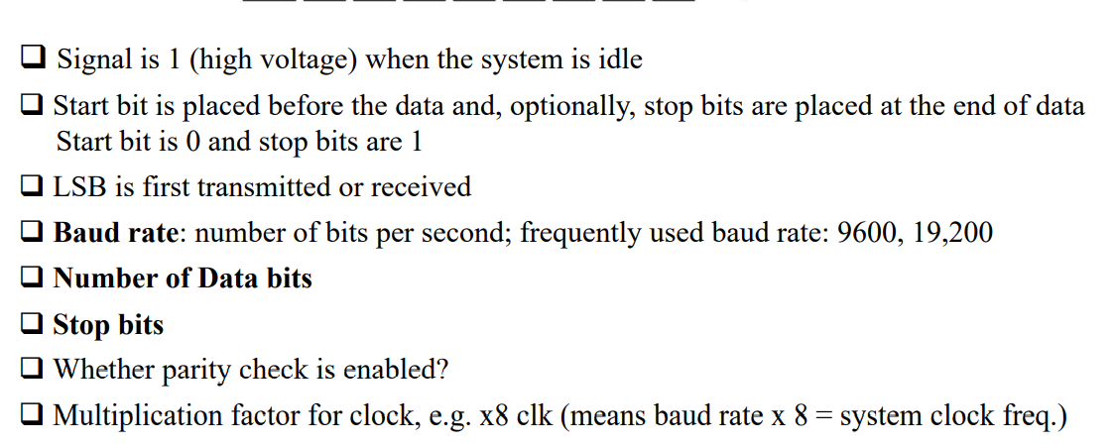
UART DATA STREAM EXAMPLE

Slide 13
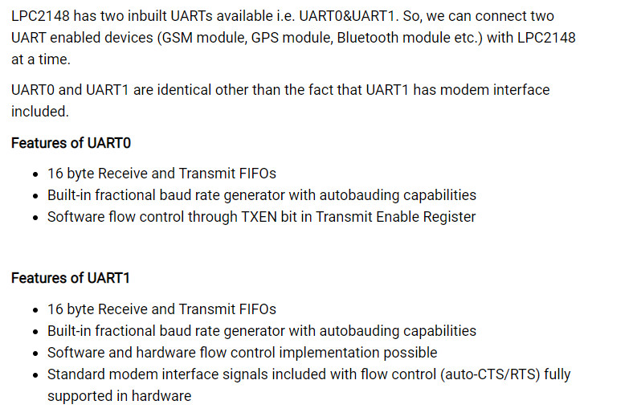
LPC2148 UART

Slide 14
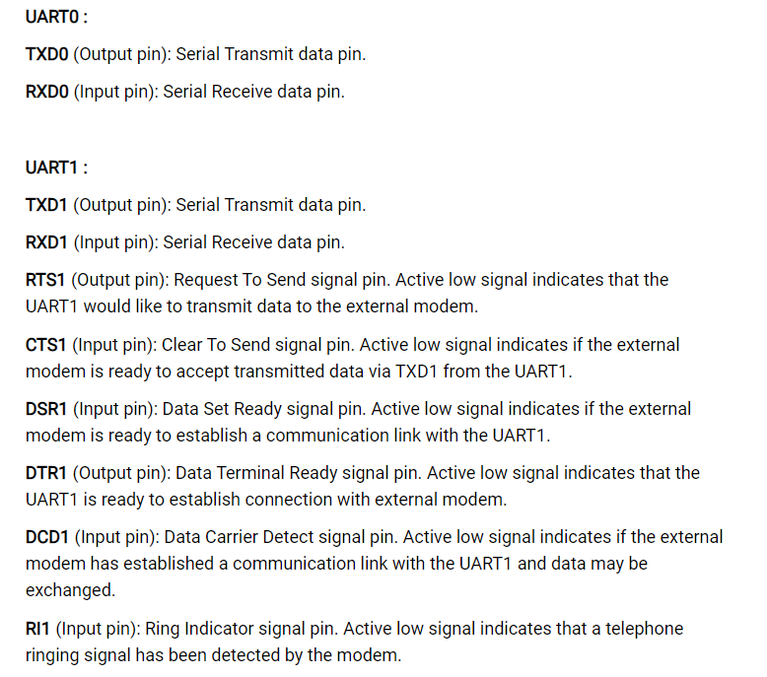
LPC2148 UART

Slide 15

UART0 Registers
U0RBR (UART0 Receive Buffer Register)-It is an 8-bit read only register.
  It is an 8-bit read only register.
  This register contains the received data.
U0THR (UART0 Transmit Holding Register)
It is an 8-bit write only register.
Data to be transmitted is written to this register.
U0DLL and U0DLM (UART0 Divisor Latch Registers)
    U0DLL is the Divisor Latch LSB.
    U0DLM is the Divisor Latch MSB.
    These are 8-bit read-write registers.
U0FDR (UART0 Fractional Divider Register)

Slide 16
UART0 Registers
U0IER (UART0 Interrupt Enable Register)
  It is a 32-bit read-write register.
  It is used to enable UART0 interrupt sources.
U0IIR (UART0 Interrupt Identification Register)
It is a 32-bit read only register.
U0LCR (UART0 Line Control Register)
It is an 8-bit read-write register.
It determines the format of the data character that is to be transmitted or received.
U0LSR (UART0 Line Status Register)
It is an 8-bit read only register.
U0TER (UART0 Transmit Enable Register)

Slide 17
UART Initialization
Configure P0.0 and P0.1 as TXD0 and RXD0 by writing 01 to the corresponding bits in PINSEL0.
Using U0LCR register, make DLAB = 1. Also, select 8-bit character length and 1 stop bit.
Set appropriate values in U0DLL and U0DLM depending on the PCLK value and the baud rate desired.
Fractional divider can also be used to get different values of baudrate.

Slide 18
UART Initialization
PCLK = 15MHz. For baud rate 9600, without using fractional divider register, from the baud rate formula,
we have,9600 = \frac{15000000}{16 * (256 * U0DLM + U0DLL)} * \frac{MulVal}{MulVal + DivAddVal}
On reset, MulVal = 1 and DivAddVal = 0 in the Fractional Divider Register.
Hence, ( 256 x U0DLM + U0DLL ) = \frac{15000000}{16 * 9600}
( 256 x U0DLM + U0DLL ) = 97.65
We can consider it to be 98 or 97. It will make the baud rate slightly less or more than 9600.
This small change is tolerable. We will consider 97.
Since 97 is less than 256 and register values cannot contain fractions,
we will take U0DLM = 0. This will give U0DLM = 97.
Make DLA = 0 using U0LCR register.

Slide 19
UART Initialization
void UART0_init(void)
{
PINSEL0 = 0x00000005; /* Enable RxD0 and TxD0 */
U0LCR = 0x00000083; /* 8 bits, no Parity, 1 Stop bit */
U0DLL = 0x000000C3; /* 9600 Baud Rate @ 30MHz VPB Clock */
U0LCR = 0x00000003; /* DLAB = 0 */
}

Slide 20
Receiving Character
Monitor the RDR bit in U0LSR register to see if valid data is available in U0RBR register.
unsigned char UART0_RxChar(void) //A function to receive a byte on UART0
{
while( (U0LSR & 0x01) == 0); //Wait till RDR bit becomes 1 which tells that receiver contains valid data
return U0RBR;
}

Slide 21
Transmitting character
Monitor the THRE bit in U0LSR register. When this bit becomes 1, it indicates that U0THR register is empty and the transmission is completed.
void UART0_TxChar(char ch) //A function to send a byte on UART0
{
U0THR = ch;
while (!(U0LSR & 0x20));
//Wait till THRE bit becomes 1 which tells that transmission is completed
}

Slide 22
Main
int main(void)
{
char receive;
VPBDIV = 0x02;
UART0_init();
while(1)
{
receive = UART0_RxChar();
UART0_TxChar(receive);
//UART0_SendString("\r\n");
}
}

Slide 23
Thank You

